Slide 1
Boolean Network Models for Transcriptional Regulation
Alissa, Aleisha, Aaron

Slide 2
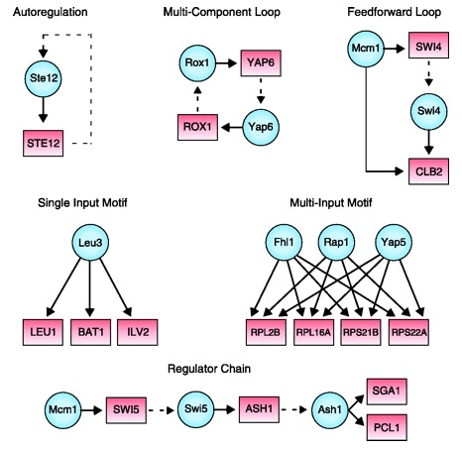
Biological Boolean Network Models:
A directed network graph where each node represents a gene, gene product, or input compound which can be either ‘on’ (1) or ‘off’ (0).
The ‘on’ or ‘off’ state is determined by Boolean functions which use ‘on’/’off’ states of nodes pointing to or inhibiting the node.
Variety of update schemes, methods: truth tables, stochastic models, threshold functions, etc.

Slide 3
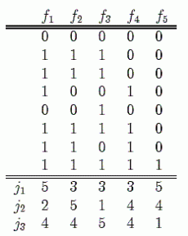
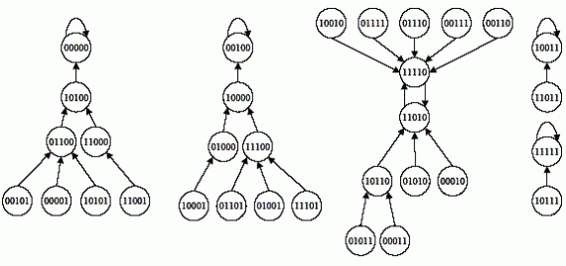
Truth Tables
Can be used to represent proteins via gene expression states.
The expression state of genes are determined by the expression states of previous genes.
There can be 2^X different models that will depend on the genes that are expressed.

Slide 4

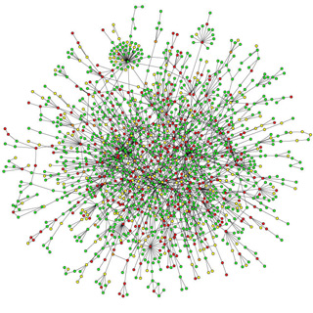
Applications
Cancer research:
Signaling network research:
In silico models of potential knock out effects:
Help run simulations to determine new investigatory pathways

Slide 5
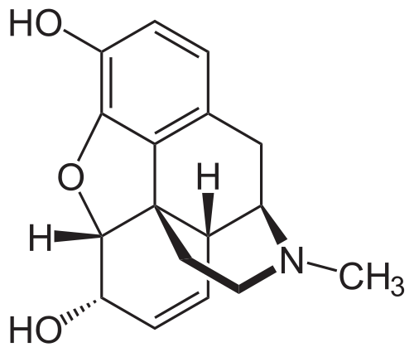
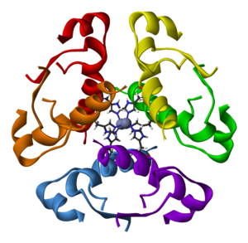
Genetically Modified E. coli:
Medical Modifications
Creates medicines such as insulin, opiates, and vaccines.
Biotechnology Modifications
Use of biotechnology to produce medicine from bacteria

Slide 6

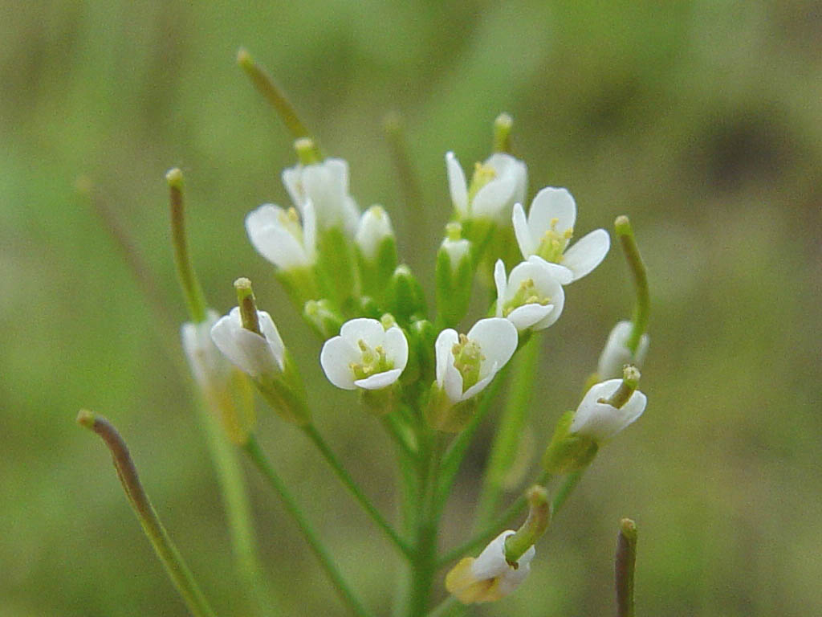
Our pathway: E. coli transgene opiate synthesis
Discovered by Bioengineers at Kyoto University:
Performed modifications by splicing genes from other bacteria.
Enzymes from Opium poppies and genes from other Bacteria Spliced into E. coli:
Coptis Japonica(Opium poppies) – Enzymes added from this plant.
Arabidopsis(Opium poppies) – Enzymes added from this plant.

Slide 7
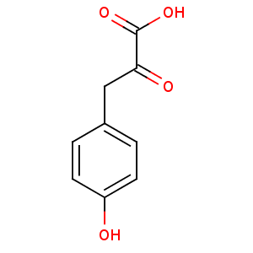
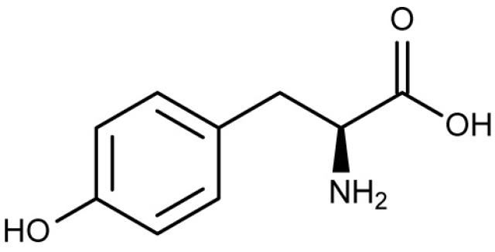
Engineered E. Coli Hydracodone production pathway:
Nodes: 14 Intermediates present in the pathway
Edges: + edges only, as it is assumed that the intermediates will all proceed down the pathway. Edges connect one node to the next in the reaction pathway.
L-tyrosine ----------------------------------→ 4-hydroxyphenyl-pyuruvate

Slide 8
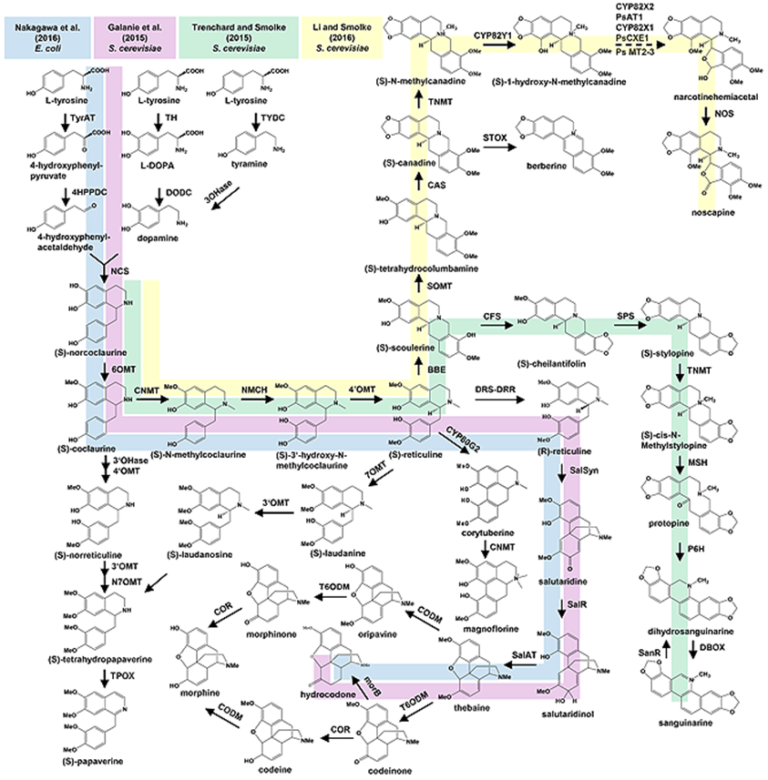

Slide 9
Our program:
A simplistic Boolean network modeler, able to fulfill the following goals:
Generate Boolean Network graphs
Allow for 1 or 0 state models of a given pathway (in our case, a metabolic pathway) by the user entering nodes, edges, and clarifying any Boolean algebraic issues to the program as it generates truth tables
Run a simulation given a starting vector of node states using simultaneous update scheme and Boolean Functions
Show simulation results in graph form, and show the metabolic network
Allow for file I/O with the models to allow the same network model to be pulled up and re-ran later without complete data re-entry

Slide 10
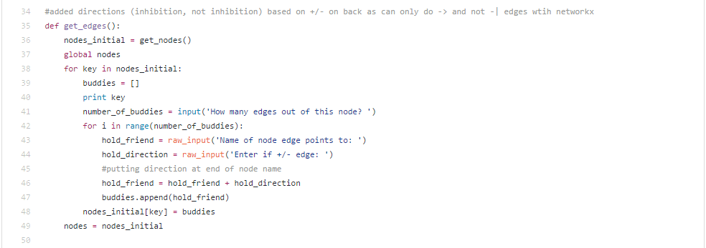
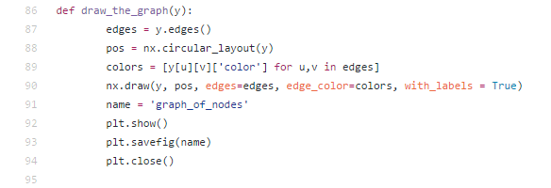
Python code
Libraries we used:
MatPlotLib
NetworkX
Examples from our code:

Slide 11
Small test:
We included:

Slide 12
Small Test: Continued

Slide 13
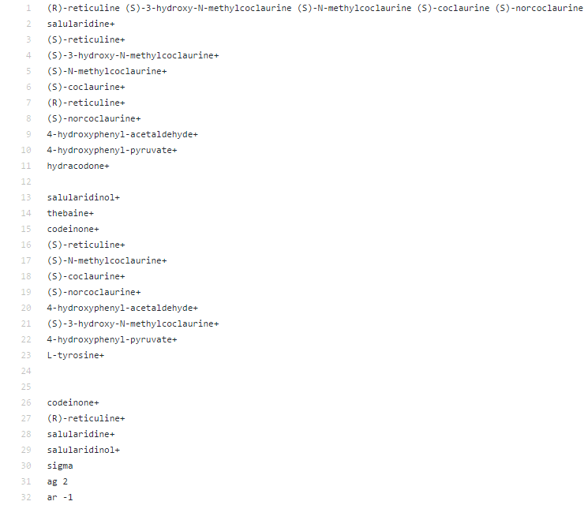
Example Text file:

Slide 14
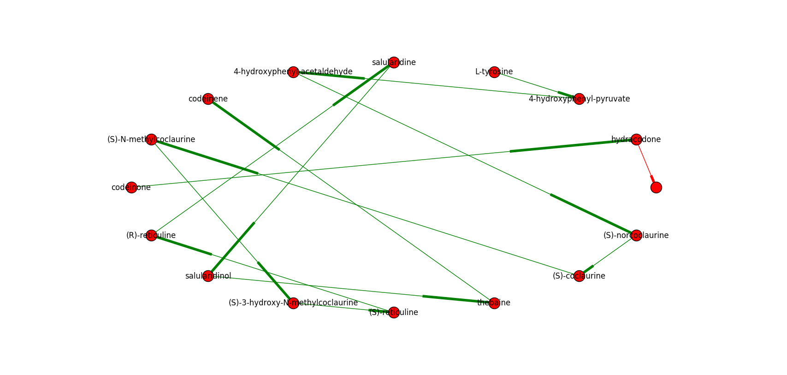
Entering our network:

Slide 15
Running a simulation for N=# generations:
Results image, results per generation.

Slide 16
Possible Improvements:
Add in more E. coli metabolic pathways which used (X) as a substrate to make the model more realistic
For example, integrate the model network into already developed E. coli networks which are available at (blah blah)
Allow for asynchronous updating, or kinetic parameter integration
Create own graph generator functions, which can handle self-directed edge visualization in graphs

Slide 17
Sources:
http://www.kyoto-u.ac.jp/en/research/research_results/2015/160205_1.html
http://onlinelibrary.wiley.com/doi/10.1002/biot.201600145/full
Nakagawa, A., Minami, H., Kim, J. S., Koyanagi, T. et al., A bacterial platform for fermentative production of plant alkaloids. Nat. Commun. 2011, 2, 326.

